Slide 1
Dijkstra Algorithm

Slide 2
Dijkstra Algorithm
Dijkstra Algorithm is a very famous greedy algorithm.
It is used for solving the single source shortest path problem.
It computes the shortest path from one particular source node to all other remaining nodes of the graph.

Slide 3
Conditions-
It is important to note the following points regarding Dijkstra Algorithm-
Dijkstra algorithm works only for connected graphs.
Dijkstra algorithm works only for those graphs that do not contain any negative weight edge.
Dijkstra algorithm works for directed as well as undirected graphs.

Slide 4
Implementation-
Step-01:
In the first step. two sets are defined-
One set contains all those vertices which have been included in the shortest path tree.
In the beginning, this set is empty.
Other set contains all those vertices which are still left to be included in the shortest path tree.
In the beginning, this set contains all the vertices of the given graph.

Slide 5
Step-02:
For each vertex of the given graph, two variables are defined as-
Π[v] which denotes the predecessor of vertex ‘v’
d[v] which denotes the shortest path estimate of vertex ‘v’ from the source vertex.

Slide 6
Initially, the value of these variables is set as-
The value of variable ‘Π’ for each vertex is set to NIL i.e. Π[v] = NIL
The value of variable ‘d’ for source vertex is set to 0 i.e. d[S] = 0
The value of variable ‘d’ for remaining vertices is set to ∞ i.e. d[v] = ∞

Slide 7
Step-03
The following procedure is repeated until all the vertices of the graph are processed-
Among unprocessed vertices, a vertex with minimum value of variable ‘d’ is chosen.
Its outgoing edges are relaxed.
After relaxing the edges for that vertex, the sets created in step-01 are updated.

Slide 8
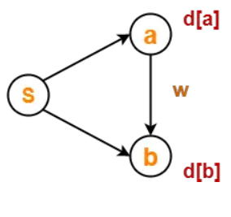
What is Edge Relaxation?
Consider the edge (a,b) in the following graph-

Slide 9
Here, d[a] and d[b] denotes the shortest path estimate for vertices a and b respectively from the source vertex ‘S’.
Now,
If d[a] + w < d[b]
then d[b] = d[a] + w and Π[b] = a
This is called as edge relaxation.

Slide 10
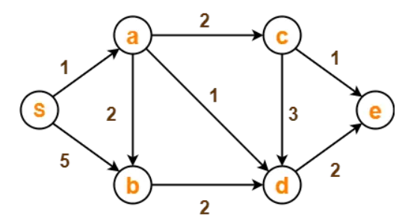
PRACTICE PROBLEM BASED ON DIJKSTRA ALGORITHM-
Using Dijkstra’s Algorithm, find the shortest distance from source vertex ‘S’ to remaining vertices in the following graph.Also, write the order in which the vertices are visited.

Slide 11
Step-01:
The following two sets are created-
Unvisited set : {S , a , b , c , d , e}
Visited set : { }

Slide 12
Step-02:
The two variables Π and d are created for each vertex and initialized as-
Π[S] = Π[a] = Π[b] = Π[c] = Π[d] = Π[e] = NIL
d[S] = 0
d[a] = d[b] = d[c] = d[d] = d[e] = ∞

Slide 13
Step-03:
Vertex ‘S’ is chosen.
This is because shortest path estimate for vertex ‘S’ is least.
The outgoing edges of vertex ‘S’ are relaxed.

Slide 14
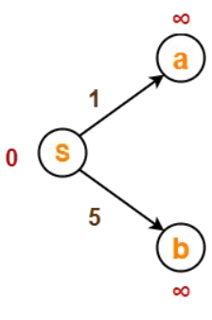
Before Edge Relaxation-
Now,
d[S] + 1 = 0 + 1 = 1 < ∞
∴ d[a] = 1 and Π[a] = S
d[S] + 5 = 0 + 5 = 5 < ∞
∴ d[b] = 5 and Π[b] = S

Slide 15
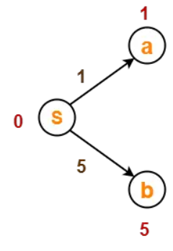
After edge relaxation, our shortest path tree is-
Now, the sets are updated as-
Unvisited set : {a , b , c , d , e}
Visited set : {S}

Slide 16
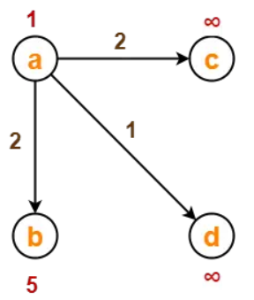
Step-04:
Vertex ‘a’ is chosen.
This is because shortest path estimate for vertex ‘a’ is least.
The outgoing edges of vertex ‘a’ are relaxed.
Before Edge Relaxation-

Slide 17
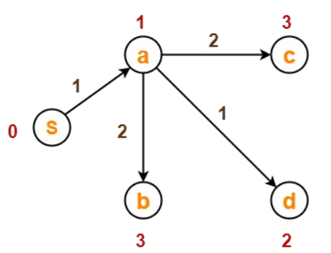
Now,
d[a] + 2 = 1 + 2 = 3 < ∞
∴ d[c] = 3 and Π[c] = a
d[a] + 1 = 1 + 1 = 2 < ∞
∴ d[d] = 2 and Π[d] = a
d[b] + 2 = 1 + 2 = 3 < 5
∴ d[b] = 3 and Π[b] = a
After edge relaxation, our shortest path tree is-

Slide 18
Now, the sets are updated as-
Unvisited set : {b , c , d , e}
Visited set : {S , a}
Step-05:
Vertex ‘d’ is chosen.
This is because shortest path estimate for vertex ‘d’ is least.
The outgoing edges of vertex ‘d’ are relaxed.

Slide 19
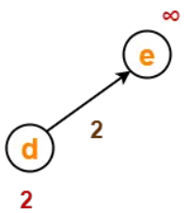
Before Edge Relaxation-
Now,
d[d] + 2 = 2 + 2 = 4 < ∞
∴ d[e] = 4 and Π[e] = d

Slide 20
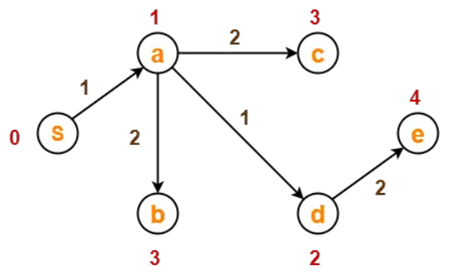
After edge relaxation, our shortest path tree is-
Now, the sets are updated as-
Unvisited set : {b , c , e}
Visited set : {S , a , d}

Slide 21

Step-06:
Vertex ‘b’ is chosen.
This is because shortest path estimate for vertex ‘b’ is least.
Vertex ‘c’ may also be chosen since for both the vertices, shortest path estimate is least.
The outgoing edges of vertex ‘b’ are relaxed.
Before Edge Relaxation-

Slide 22
Now,
d[b] + 2 = 3 + 2 = 5 > 2
∴ No change
After edge relaxation, our shortest path tree remains the same as in Step-05.
Now, the sets are updated as-
Unvisited set : {c , e}
Visited set : {S , a , d , b}

Slide 23
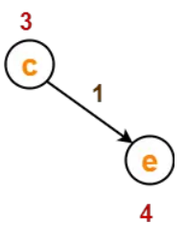
Step-07:
Vertex ‘c’ is chosen.
This is because shortest path estimate for vertex ‘c’ is least.
The outgoing edges of vertex ‘c’ are relaxed.
Before Edge Relaxation-

Slide 24
Now,
d[c] + 1 = 3 + 1 = 4 = 4
∴ No change
After edge relaxation, our shortest path tree remains the same as in Step-05.
Now, the sets are updated as-
Unvisited set : {e}
Visited set : {S , a , d , b , c}

Slide 25
Step-08:
Vertex ‘e’ is chosen.
This is because shortest path estimate for vertex ‘e’ is least.
The outgoing edges of vertex ‘e’ are relaxed.
There are no outgoing edges for vertex ‘e’.
So, our shortest path tree remains the same as in Step-05.
Now, the sets are updated as-
Unvisited set : { }
Visited set : {S , a , d , b , c , e}

Slide 26
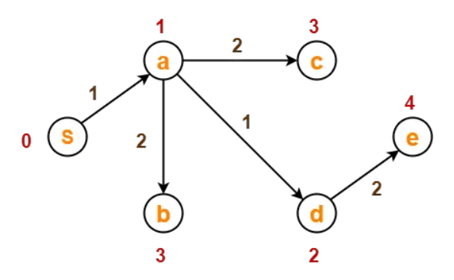
Now,
All vertices of the graph are processed.
Our final shortest path tree is as shown below.
It represents the shortest path from source vertex ‘S’ to all other remaining vertices.

Slide 27
The order in which all the vertices are processed is :
S , a , d , b , c , e.

